Slide 1
Question 5,6,7,8
Library Online Store

Slide 2
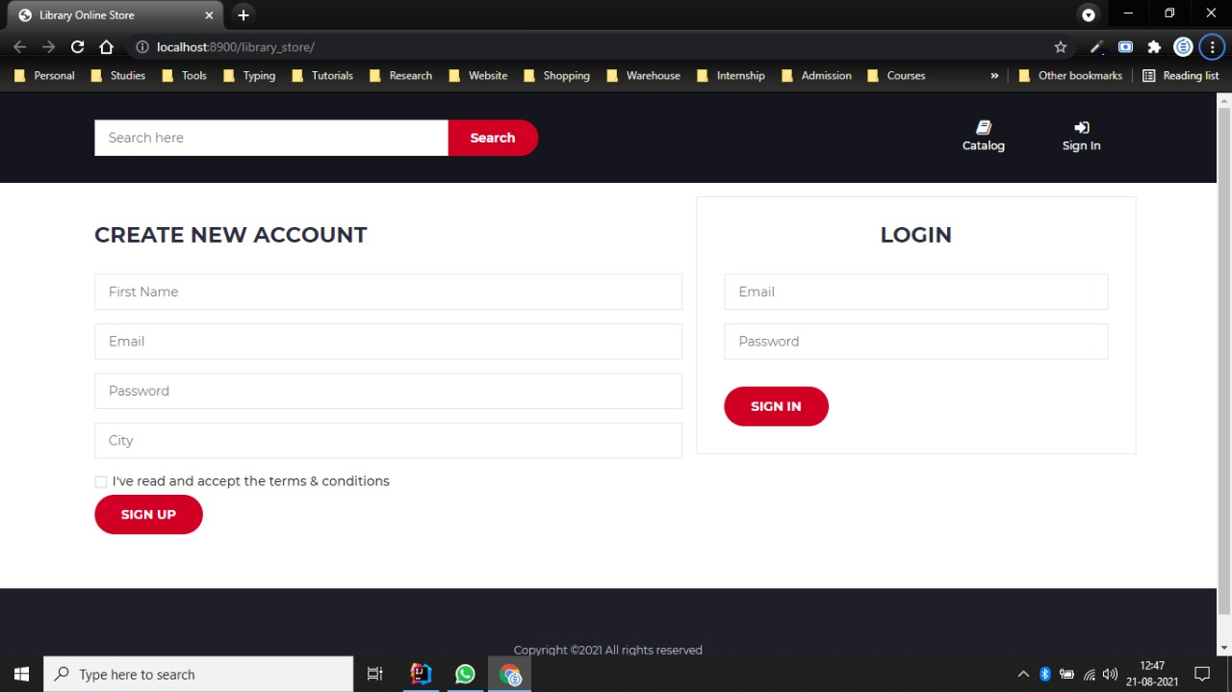
Login page

Slide 3
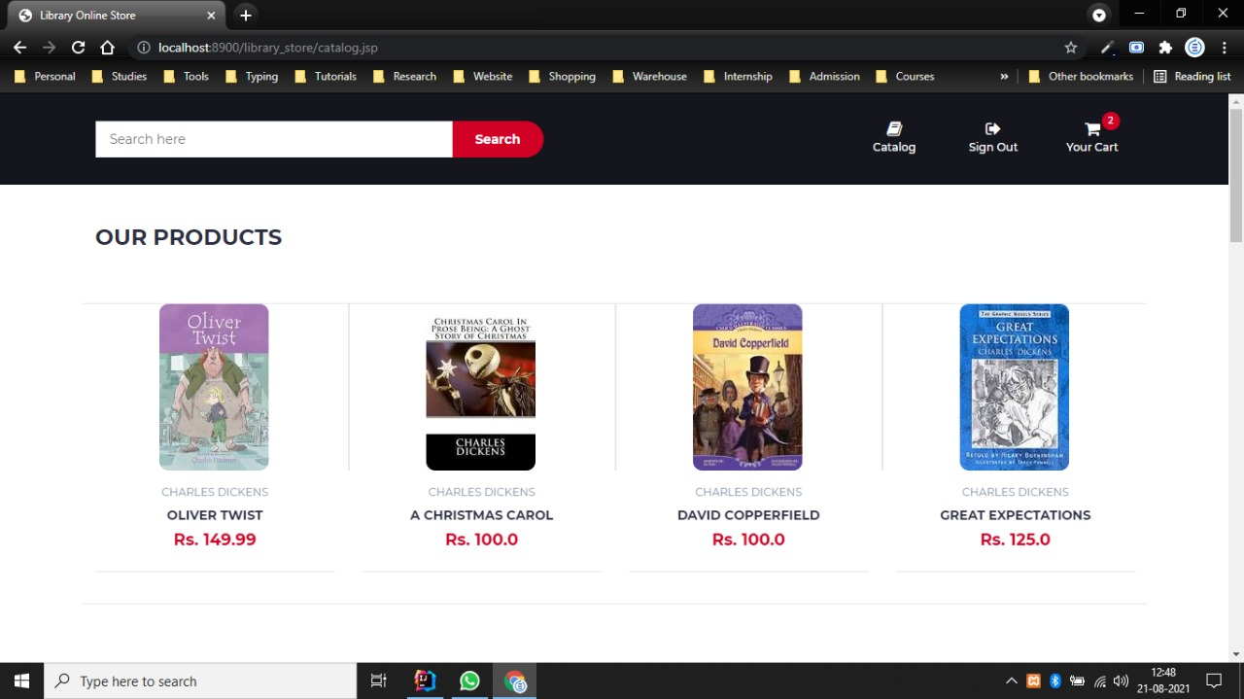
Catalogue Page

Slide 4
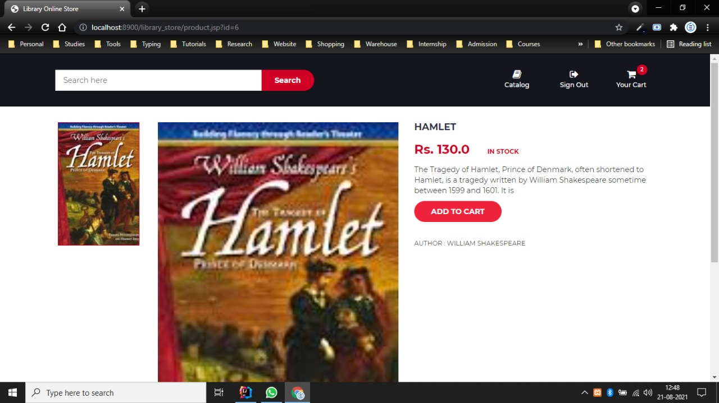
Product Page

Slide 5
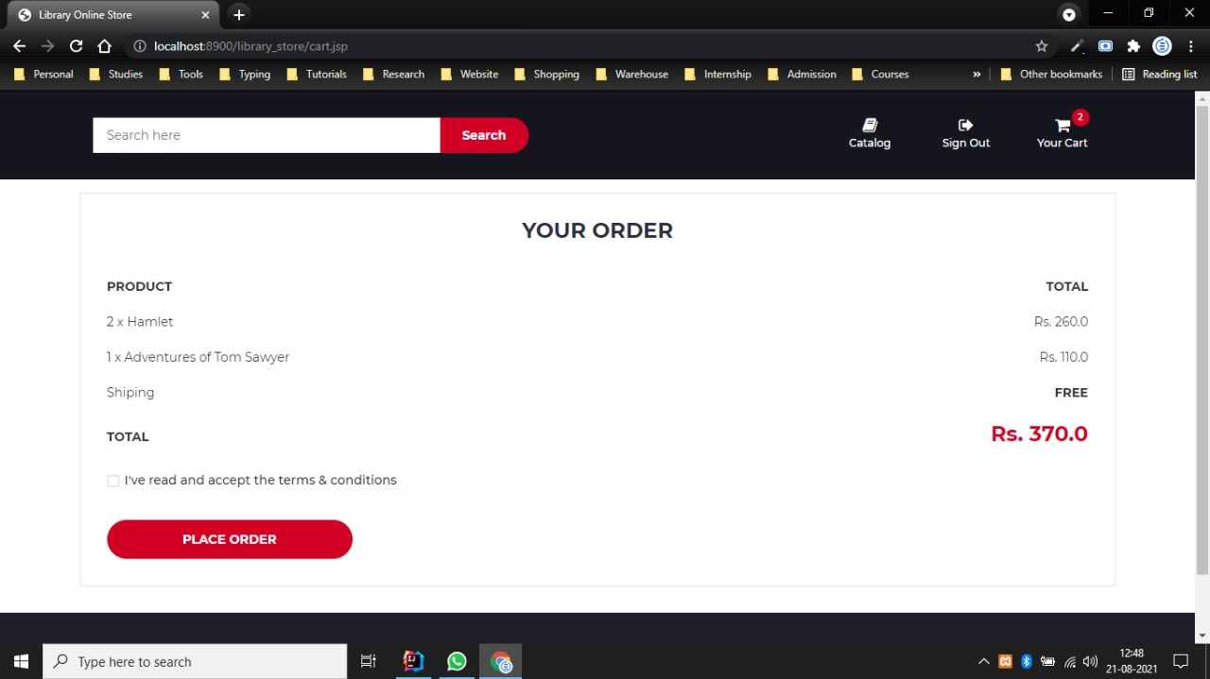
Cart Page

